Slide 1
Current and Future Status of IoT
Sonoyama Keisuke
Notes:
Hello. I’m Keisuke Sonoyama and welcome to my presentation about Current and Future Status of IoT.

Slide 2
Outline
Introduction
Current Status of IoT
Example of IoT
Future Status of IoT
Conclusion
Notes:
This is the outline. Firstly, I’ll introduce you about IoT. Secondly, I’m going to talk about Current Status of IoT. Thirdly, I’ll show example of IoT. Then I’ll talk about Future Status of IoT. Finally, I’ll look at conclusion.
Now, let me introduce the IoT.

Slide 3

Introduction
What is IoT?
System for connecting things to the Internet
The purpose of IoT
Compensate for labor shortages
Improve operational efficiency
Develop services and products
Gather information from things
Send information to things
Operate things
Notes:
Do you know What is IoT? IoT is the system for connecting things to the Internet. By connecting things to the Internet, we can gather information from things, send information to things and operate things.
Next, let’s discuss the purpose of the IoT. By introducing IoT, we can compensate for labor shortages, improve operational efficiency and develop services and products.
For these reasons, many companies use IoT.

Slide 4
Current Status of IoT
Only 12.4% of companies have implemented IoT
IoT is growing rapidly
Increasing number of connected devices
Expanding Use Cases
Notes:
Now I’d like to focus on Current Status of IoT. According to a survey, only 12.4% of companies in Japan have implemented IoT. I think the number of companies which use IoT are surprisingly few. But, IoT is growing rapidly in recent years and the number of devices connected to the IoT is growing. In addition, the use case of IoT has been expanding.

Slide 5
Example of IoT
IoT in Agriculture
Notes:
Now, I’d like to show you a example of IoT.

Slide 6
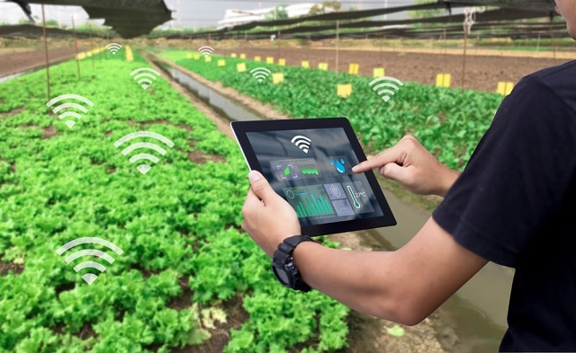
IoT in Agriculture
Sensors calculate the appropriate timing and amount of watering and fertilizer application.
Automation
Notes:
I’ll talk about IoT in agriculture. This is called “スマート農業”. Agriculture has many problems. One of them is that agriculture is troubled by a lack of successors due to a declining birthrate and aging population. Agriculture uses IoT to solve problems. Agriculture can be automated because of IoT. Sensors calculate the appropriate timing and amount of watering and fertilizer application. This automation improves the shortage of successors in agriculture.

Slide 7
Future Status of IoT
IoT market size is growing every year and is expected to exceed 10 trillion yen by 2025
Notes:
OK, so now I’d like to turn to my next point, which is Future Status of IoT. IoT market size is growing every year and is expected to exceed 10 trillion yen by 2025.

Slide 8
Future Status of IoT
Furthermore, as IoT becomes more prevalent, we need to process vast amounts of data.
5G will help IoT spread
The vast amount of data gathered by IoT devices need to be analyzed more efficiently and accurately
AI will help IoT grow
Notes:
Furthermore, as IoT becomes more prevalent, we need to process vast amounts of data, but 5G will help IoT spread. 5G can communicate large amounts of data at ultra-high speeds and with ultra-low latency compared to conventional systems. The vast amount of data gathered by IoT devices can be analyzed by AI more efficiently and accurately than by humans; AI is still in its developmental stage, and as machine learning and deep learning evolve, IoT will continue to grow.

Slide 9
Conclusion
IoT has the potential to be used in many areas and will continue to grow even more.
IoT will change our life dramatically.
Notes:
In conclusion, IoT has the potential to be used in many areas and will continue to grow even more. And it will be used more and more in our daily life and will be more familiar to us. IoT will change our life dramatically.

Slide 10
References
[1]SAKURA internet, ”IoTとは？意味や定義を簡単に解説！”, https://iot.sakura.ad.jp/column/about-iot/, さくらのIoT, Dec.2022, (accessed May.2023)

Slide 11

Thank you for listening

